Slide 1
ChatGPT as a Tutor for Argumentative Essay Writing
12.06.2023
Maxim Ryakhovskiy

Slide 2
Background
Conversational Agent (CA) - dialogue system that responds using human language
Pedagogical Conversational Agent (PCA) – A subset of conversational agent used in education
ChatGPT – language model developed by OpenAI, designed to generate human-like text responses given a prompt or conversation
Khosravi et al. 2022
Kuhn et al. 1993
Jürgen et al. 2023
Weber et al. 2021
Notes:
A conversational agent is any dialogue system that conducts natural language processing (NLP) and responds automatically using human language
PCA in education, we have results that they work
ChatGPT is LLM developed by OpenAI

Slide 3


Overview
Writing skills are important
Argumentative skills are important
Large classrooms
ChatGPT possesses remarkable abilities
No study of LLM in argumentative writing
Research question
PCAs are efficient
Liu et al. 2023
Bang et al. 2023
Wellnhammer et al. 2020
Notes:
Writing skills are extremely important
In large classrooms it is difficult for educator to provide deep feedback.
There are plenty of prototypes for education purpose but only few of them are actually used.
outstanding capabilities in natural language generation, question answering, content creation, and text summarization
Plenty of research is done around ChatGPT, also in education field

Slide 4

Research question
How can ChatGPT be embedded as a conversational writing tutor to support students?
Notes:
Use chatbots as teachers to improve skills and not statis learning. Test AAI in education settings
On one side we have PCA which has been proven to have a positive outcome. On other side we have LLM that are being tested

Slide 5
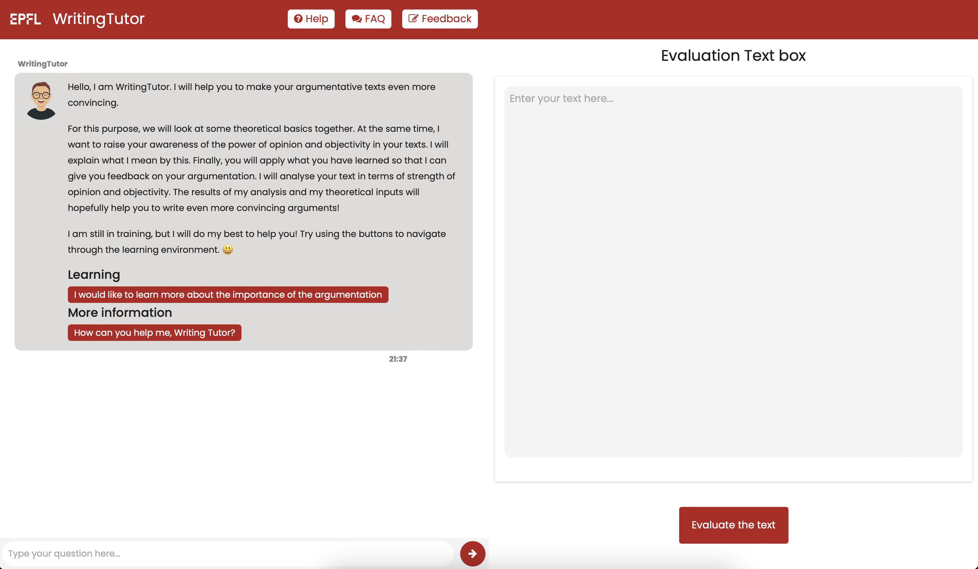
WritingTutor
WritingTutor comprises a rule-based chatbot that assists students in enhancing their argumentative skills, as well as a feedback mechanism that evaluates students’ essays.
F1
F2
F3
F4

Slide 6

Main Improvements
ChatGPT-based version → Dynamic
Inherited version → Static
Multi-language adaptation and translation in English
Develop and test of ChatGPT-based conversational agent and evaluation mechanism
Implement Split-screen design
11 semi-structured interviews
Notes:
Code refactoring
We improve the inherited WritingTutor by conducting 11 semi-structured interviews.

Slide 7
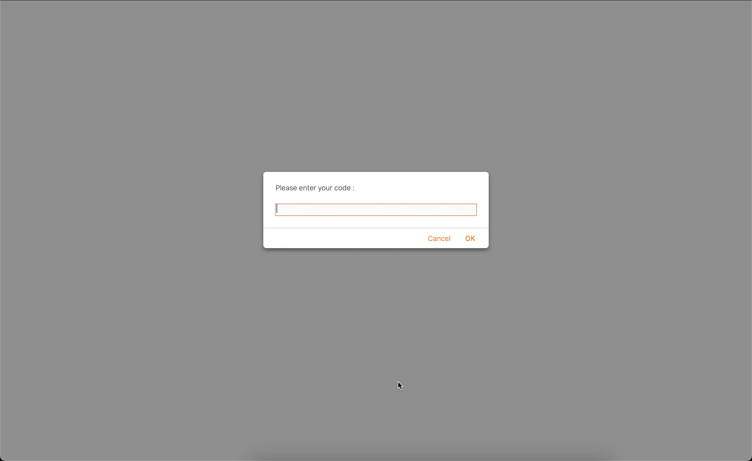
Demo
Notes:
Dynamic works the same way, but the content of the messages changes and the feedback is different

Slide 8
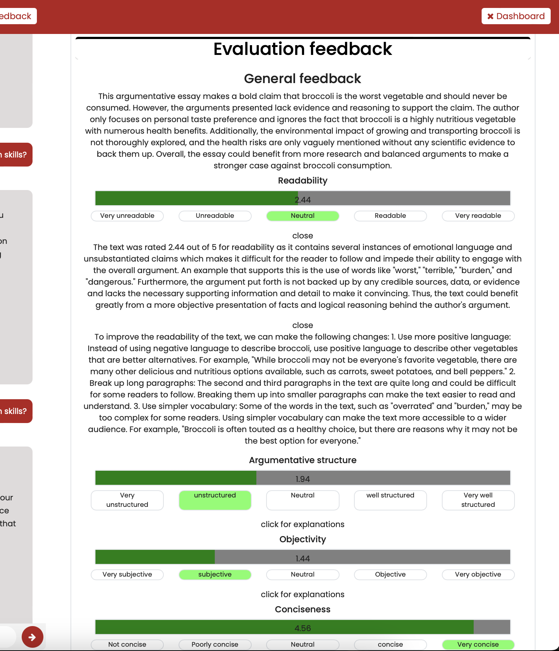
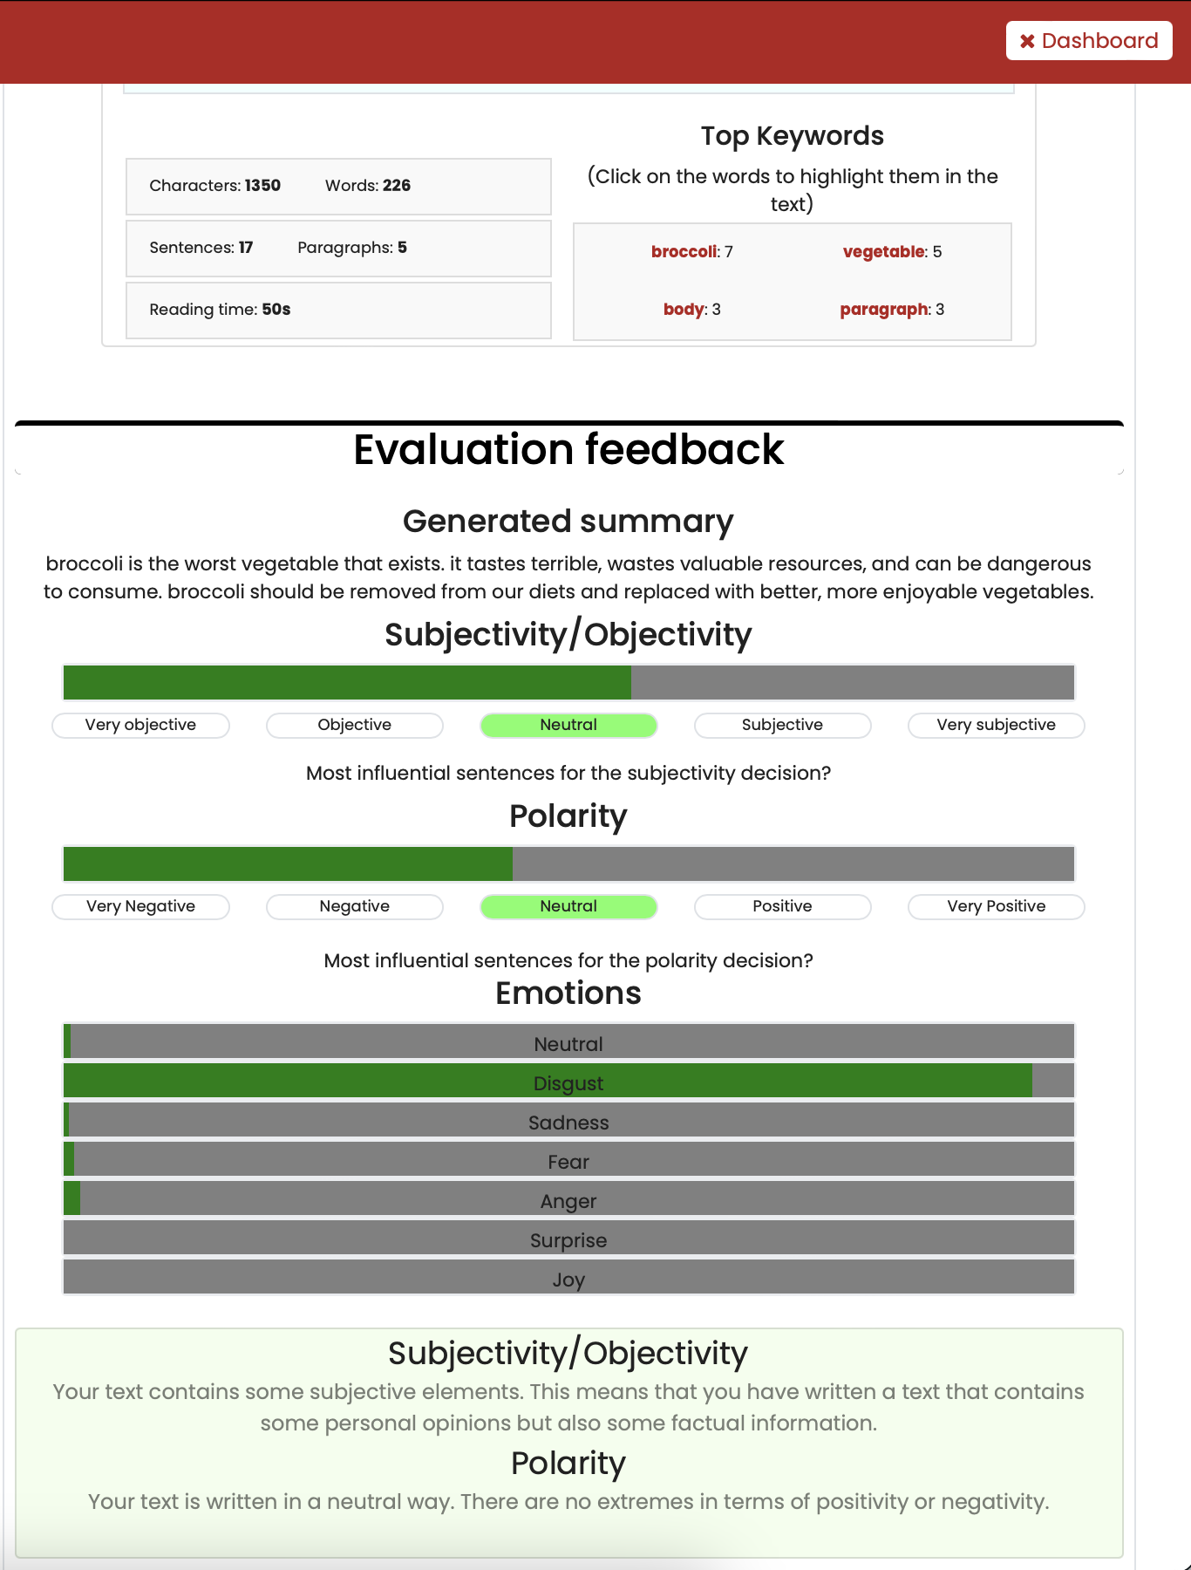
Evaluation feedback
F1
F2
F5
F3
F6
F7
F4
F8
Dynamic
Static
Notes:
Dynamic work in the same way except, from design point of view, the feedback is different
To generate feedback server makes 13 requests
Highlighted sentences for static

Slide 9

Methodology
Carried out an experiment where the participants were asked to evaluate the two versions of WritingTutor.
For Static and Dynamic versions do:
Explore the conversational agent of the WritingTutor
Structure of the argument
Strength of the argument
Objectivity of the text
Write an essay on the topic of "Benefits of Traveling to the USA”
Receive feedback from the WritingTutor
Fill satisfaction form
11 people
Notes:
6 of them were men
Different academic background: education, architecture, biochemical engineering, computer science

Slide 10
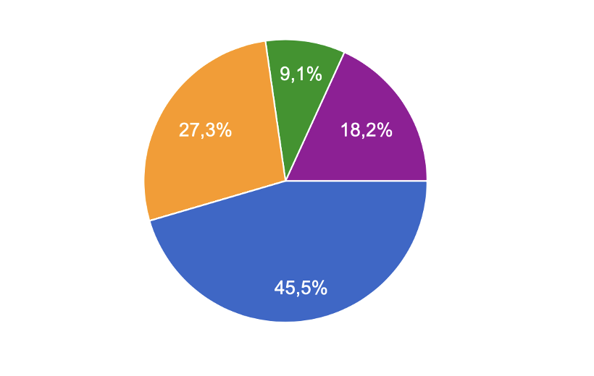
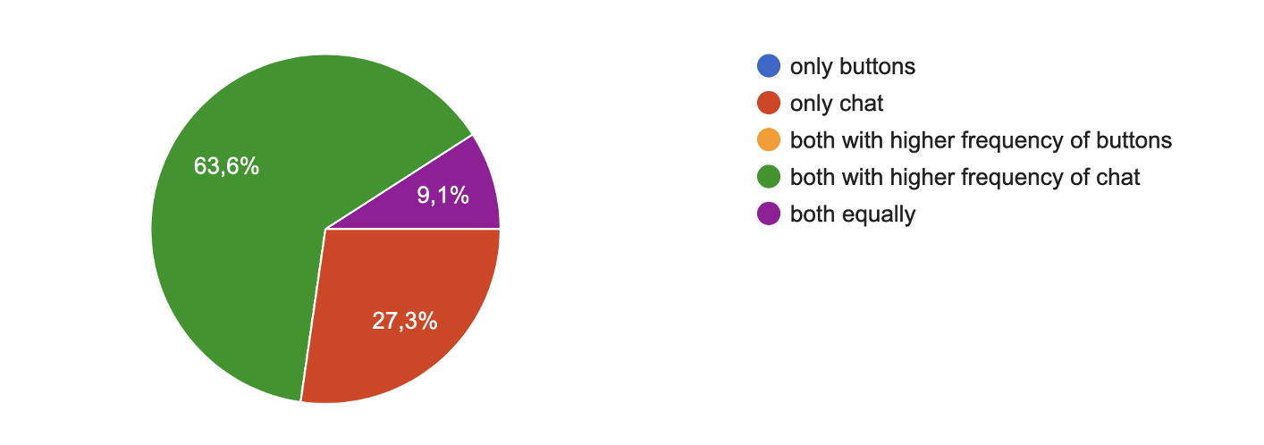
Results
Participants showed a preference for using navigational buttons in the static version, while they favored the conversational option in the ChatGPT-based version.
static
dynamic
Preference of interaction with the chatbot among users
“it would have been impossible to find correct information without buttons”
“the (dynamic) bot is slower but the text explains everything much better respect to the static one. I can make any question and get answer”
Notes:
static return random sometimes,
dynamic slow but able to hold a conversation

Slide 11
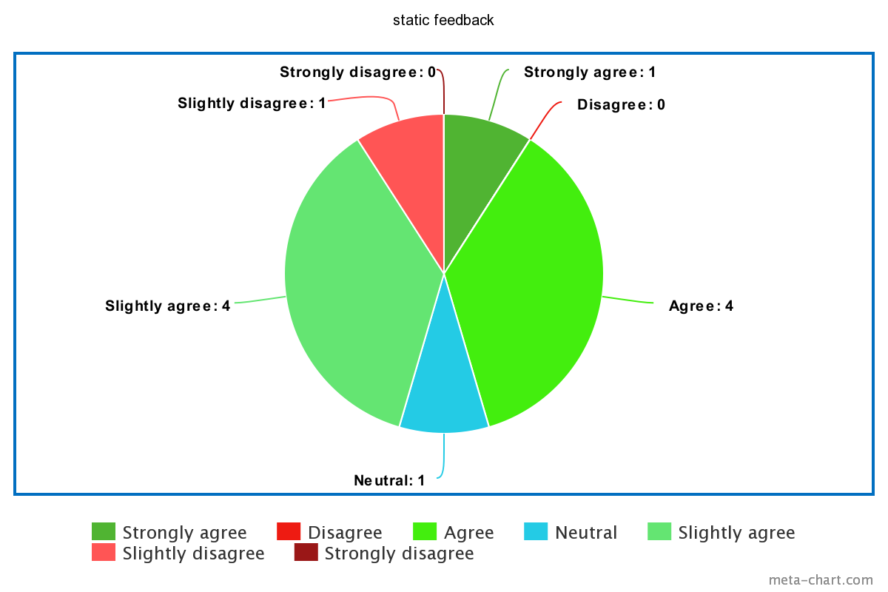
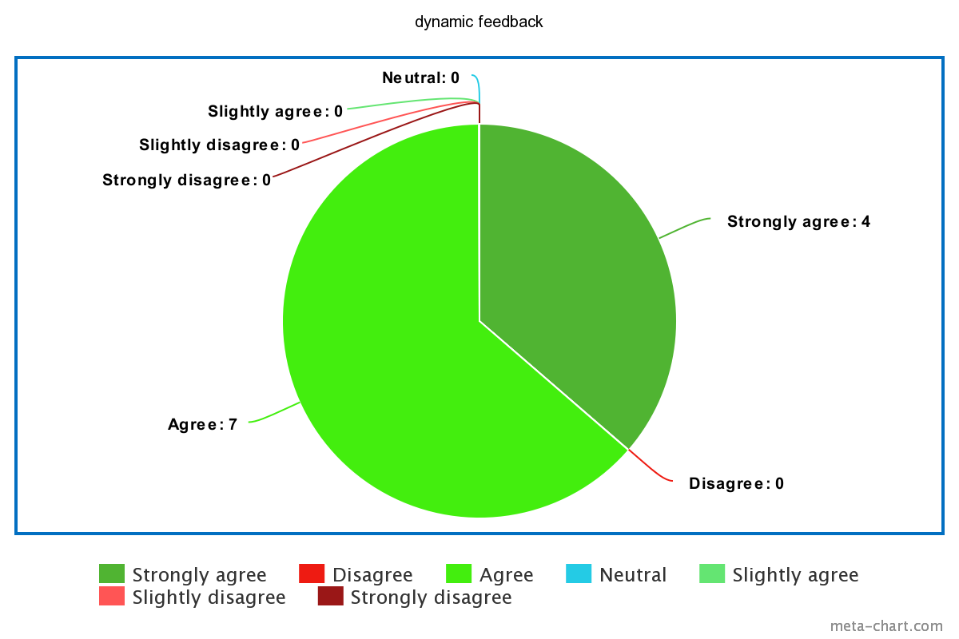
Results
Dynamic feedback was preferred by the participants.
The provided feedback was helpful?
Static
Dynamic
“I like that you can see the sentences highlighted. However, they are sometimes wrong. I would like to know how to improve my skills, it is not said”
“the dynamic version is much slower, but the feedback provided it much better. it is good to have some explanations about mistakes in the essay”
Notes:
TODO, feedback results and overall results

Slide 12
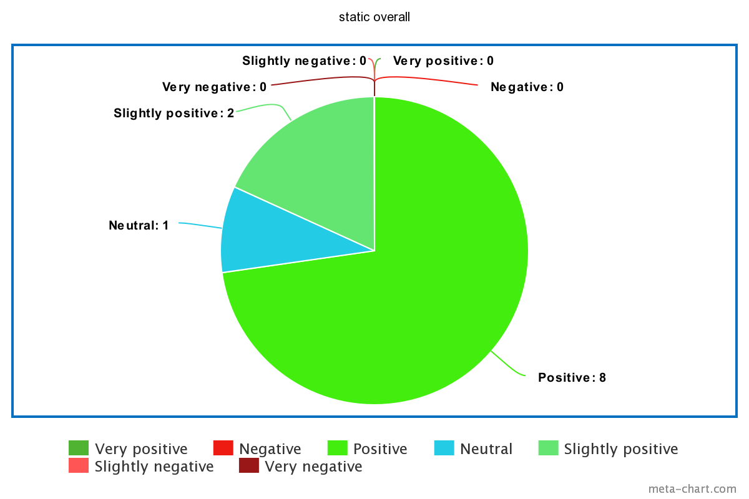
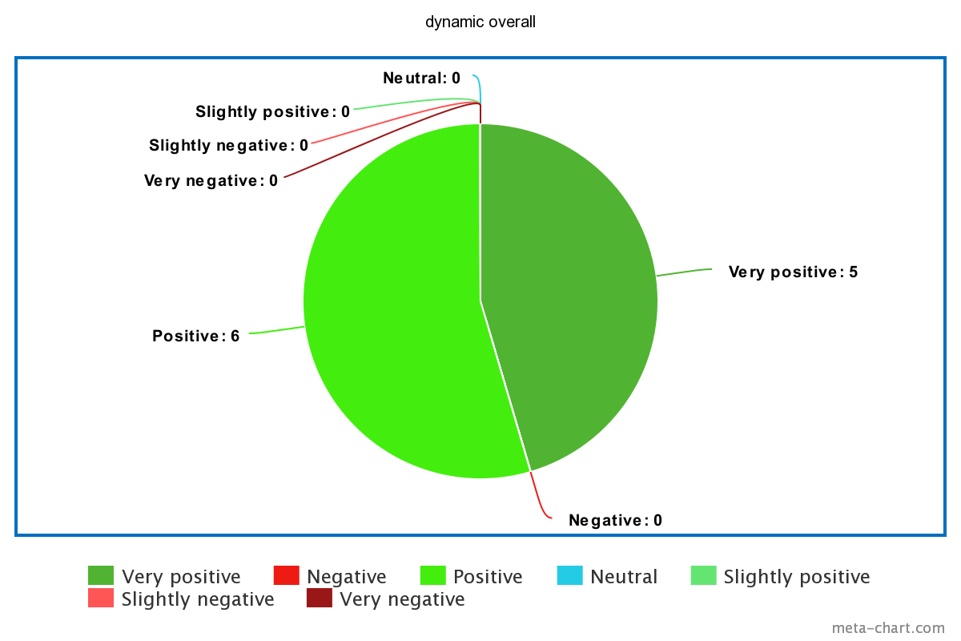
Results
In general, the dynamic version is perceived to be superior compared to the static one.
Overall, how would you describe the experience with the dynamic system?
Static
Dynamic
“Even though dynamic is slower, the ability to hold conversation and provide very deep feedback is more important to me”
Notes:
TODO, feedback results and overall results

Slide 13

Implications
ChatGPT evaluation and conversational abilities
Potential in educational setting
Interactive evaluation
Lee et. al., 2022
Notes:
Moreover, the final feedback can be used adapted by teachers as Teacher-facing AIEd. Not only for students, but also a tool for the teachers.
Future, use LLM chatbots as assistant for the professor; extend the use of chatbots as tutors for the course. Very usefull to explain material in different ways.
interactive evaluation of chatGPT (LLM), also in educatio.

Slide 14

Limitations
SLOW
SLOW
SLOW
Full-scale experiment
ChatGPT text generation speed
Access to GPT-4
ChatGPT
Liu et al., 2023
Notes:
full-scale experiment to investigate more in-depth the chatGPT
we acknowledge that chatgpt is not perfect

Slide 15

Future work
AI-generated text detection
Continuous feedback
Evaluation metrics
Khalil et al., 2023
Notes:
We want to see if the evaluation metrics maybe change by the preference of the students
See if there are other metrics that can help to evaluation

Slide 16
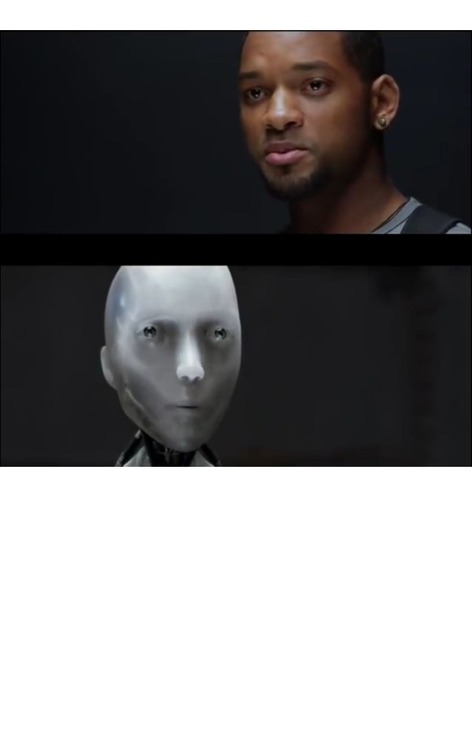

Conclusion
ChatGPT has the potential to act as a writing tutor
Can you act as a writing tutor?
Can you?
Notes:
ChatGPT should be used as a tool and help educators
Similar to calculator

Slide 17


ML4ED
Current situation
Machine Learning
EDucation
Argumentative
writing
PCA
CA
Educ-AI-tion Rebooted. Baker & Smith et. al., 2019
Notes:
What is PCA?
Chatgpt outstanding ability on variaty of NLP tasks
Good writing ability is a something that needs to be mastered, especially argumentative writing. Instructors are not always available when you need help.
Plenty of writing tutors, that can just help simply with grammar and syntax, to arrive at LLM that can generate text as you ask.
There are plenty of prototypes for education purpose but only few of them are actually used.
No continuos learning: experiment, results. No continuos integration of CA into education.
Modern PCA uses AI.
Use 4 as 4sure(for sure) for final presentation

Slide 18
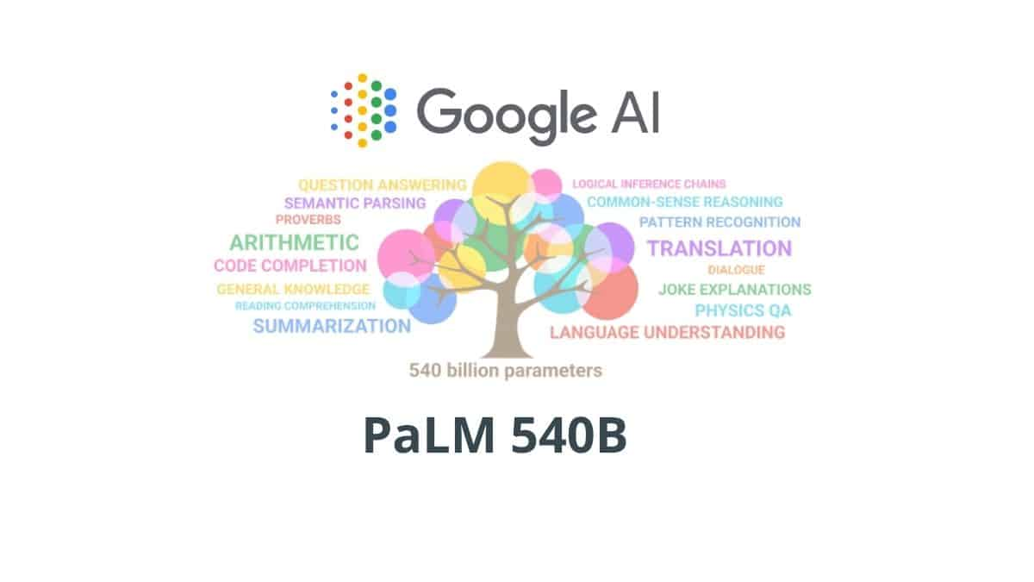

Current situation in the world
(PCA)
Argumentative
Writing PCA
PCA
CA
AI
CA - Conversational agent
PCA - Pedagogical Conversational agent
Educ-AI-tion Rebooted. Baker & Smith et. al., 2019
AI-enabled adaptive learning systems: A systematic mapping of the literature. Kabudi et. al., 2021
PaLM: Scaling Language Modeling with Pathways. Chowdhery et. al., 2022
Language Models are Few-Shot Learners. Brown et. al., 2020
Notes:
What is PCA?
A conversational agent is any dialogue system that conducts natural language processing (NLP) and responds automatically using human language.
Chatgpt outstanding ability on variaty of NLP tasks
Plenty of writing tutors, that can just help simply with grammar and syntax, to arrive at LLM that can generate text as you ask.
There are plenty of prototypes for education purpose but only few of them are actually used.
No continuos learning: experiment, results. No continuos integration of CA into education.
Modern PCA uses AI.
Everything (PCA) is a part of AI. The latest has made huge progress in the latest year, especially LLMs.
Use 4 as 4sure(for sure) for final presentation

Slide 19


What can we do?
Evaluation of ChatGPT in education
Evaluation of ChatGPT as PCA
Evaluation of ChatGPT as argumentative tutor
Evaluation?
Interactive Evaluation
AI-enabled adaptive learning systems: A systematic mapping of the literature. Kabudi et. al., 2021
ChatGPT: Bullshit spewer or the end of traditional assessments in higher education. Jürgen et al., 2023
Evaluating Human-Language Model Interaction. Lee et. al., 2022
A Multitask, Multilingual, Multimodal Evaluation of ChatGPT on Reasoning, Hallucination, and Interactivity. Bang et. al., 2023
Notes:
Here we come to the gap, there is no extensive resutls about ChatGPT as PCA. Therefor, we start by reducing the gap showing that ChatGPT is valid tutor in argumentative essay writing.
Gap between learning systems and continuos education. Especially, nothing about using AAI in argumentative writing.
No interactive evaluation of chatGPT (LLM) in education. Especially as PCA

Slide 20
Titles of papers about chatGPT being amazing
Interactive evaluation?
Notes:
MOOC
Good writing ability is a something that needs to be mastered, especially argumentative writing. Instructors are not always available when you need help.
Use chatgpt to generate feedback, It was proven to be good tool as AI detector. Promising results as feedback for students.
Todo: two types of evaluation – one of chatGPT and another one of chatGPT feedback

Slide 21
References
Conversational agents in education – a systematic literature review. Khosrawi-Rad et al., 2022
Summary of ChatGPT/GPT-4 Research and Perspective Towards the Future of Large Language Models. Yiheng Liu et al., 2023.
What if the devil is my guardian angel: ChatGPT as a case study of using chatbots in education. Ahmed Tlili et al., 2023.
Science as argument: Implications for teaching and learning scientific thinking. Deanna Kuhn. In: Science Education 77, June 1993.
Introducing chatgpt. OpenAI Nov. 2022. URL: https://openai.com/blog/chatgpt.
A Multitask, Multilingual, Multimodal Evaluation of ChatGPT on Reasoning, Hallucination, and Interactivity. Yejin Bang et al., 2023.
Explainable Artificial Intelligence in education. Hassan Khosravi et al., 2022.
Studying with the Help of Digital Tutors: Design Aspects of Conversational Agents that Influence the Learning Process. Natalie Wellnhammer et al., Jan. 2020
ChatGPT: Bullshit spewer or the end of traditional assessments in higher education. Jürgen et al., 2023
Will ChatGPT get you caught? Rethinking of Plagiarism Detection. Mohammad Khalil and Erkan Er. 2023.
Pedagogical Agents for Interactive Learning: A Taxonomy of Conversational Agents in Education Completed Research Paper. Florian Weber et al., 2021.
Evaluating Human-Language Model Interaction. Lee et. al., 2022

Slide 22
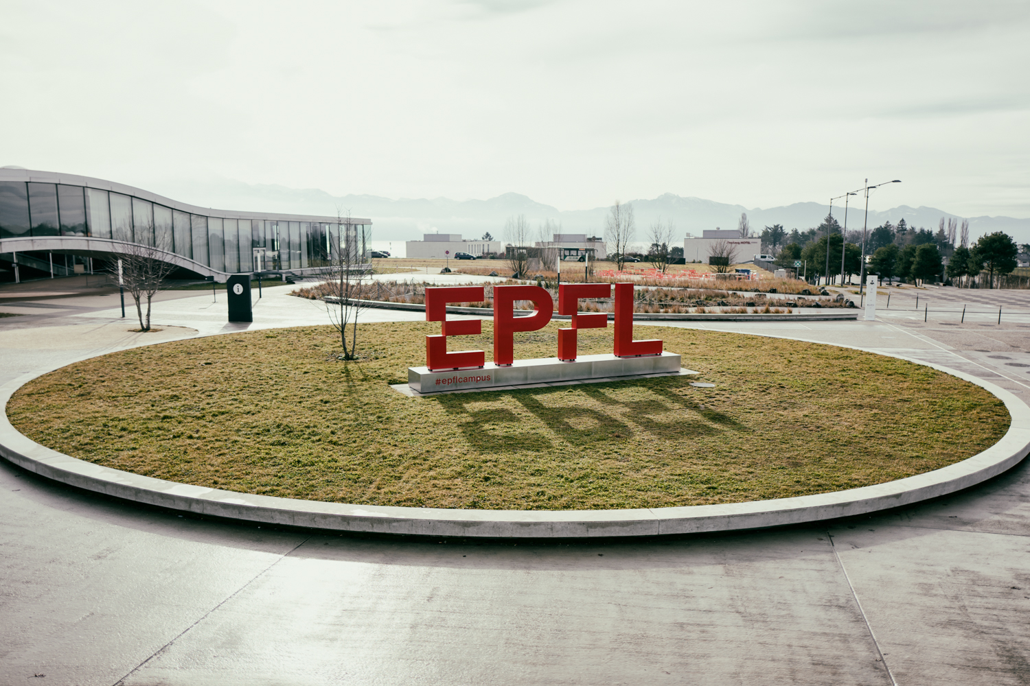
Merci
Maxim Ryakhovskiy

